Slide 1


Fundamentals of Management
Eleventh Edition
Chapter 2
The Management Environment
Copyright © 2020, 2017, 2015 Pearson Education, Inc. All Rights Reserved

Slide 2
Learning Objectives
2.1 Explain what the external environment is and why it’s important.
2.2 Discuss how the external environment affects managers.
2.3 Define organizational culture and explain why it’s important.
2.4 Describe how organizational culture affects managers.
2.5 Describe current issues in organizational culture.

Slide 3
Learning Objective 2.1
Explain what the external environment is and why it’s important.

Slide 4
What Is the External Environment and Why Is It Important?
External environment:
factors, forces, situations, and events outside the organization that affect its performance.

Slide 5
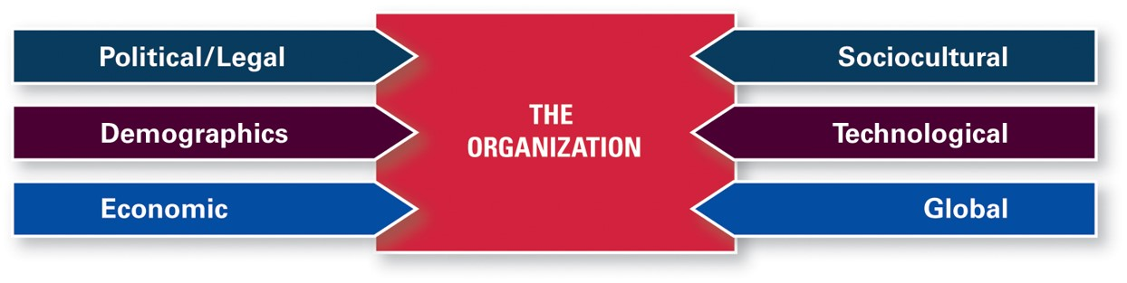
Components of the External Environment
Exhibit 2.1 Components of the External Environment
Source: Robbins, Stephen P., Coulter, Mary, Management, 13th E d., © 2016, p. 73. Reprinted and electronically reproduced by permission of Pearson Education, Inc., New York, N Y.

Slide 6
What Is the Economy Like Today?
Global productivity has moderated globally although it continues to lag in the United States.
Global trade is improving with the strongest growth in Europe and Asia.
U.S. employment is up.
Many U.S. workers despite having a steady job do not have a reliable income.
Health-care law mandates are encouraging companies in low-wage industries to use part-time workers.
Is the American Dream still possible?

Slide 7
Economic Inequality
Harris Interactive Poll:
Only 10 percent of adults think economic inequality is “not a problem at all.”

Slide 8
The Sharing Economy
Asset owners share with other individuals through peer-to-peer service, for a set fee, their underutilized physical assets or their knowledge, expertise, skills, or time.

Slide 9
Demographics
Demography is destiny.
Age Cohorts
Baby Boomers
Gen X
Gen Y
Gen Z

Slide 10
Learning Objective 2.2
Discuss how the external environment affects managers.

Slide 11
How Does External Environment Affect Managers?
Jobs and employment
Assessing environmental uncertainty
Managing stakeholder relationships

Slide 12
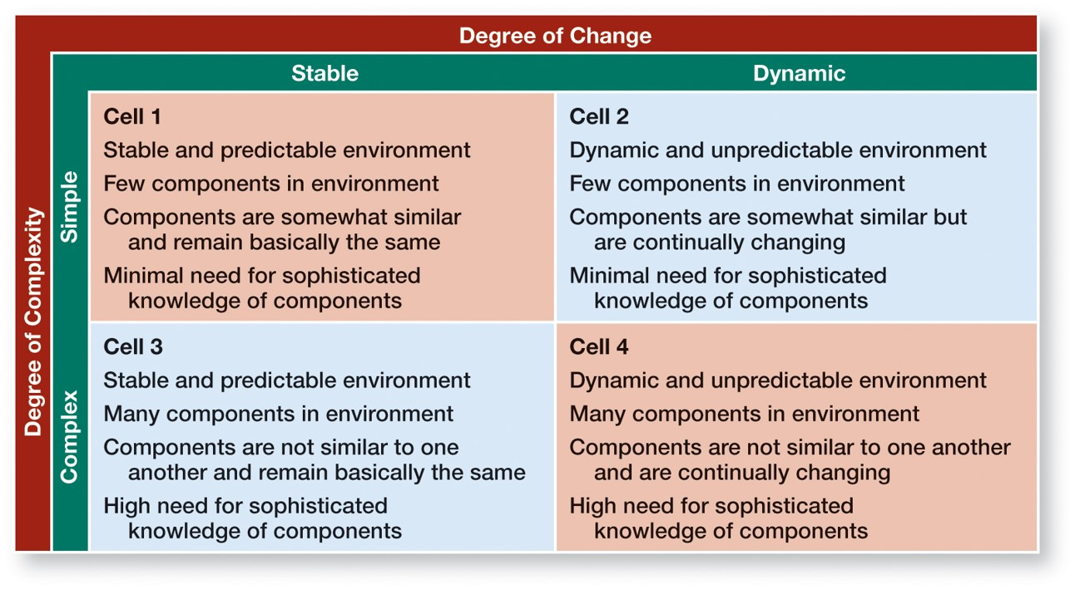
Assessing Environmental Uncertainty
Exhibit 2.2 Environmental Uncertainty Matrix

Slide 13
Managing Stakeholder Relationships
Stakeholders:
any constituencies in an organization’s environment that are affected by that organization’s decisions and actions.

Slide 14
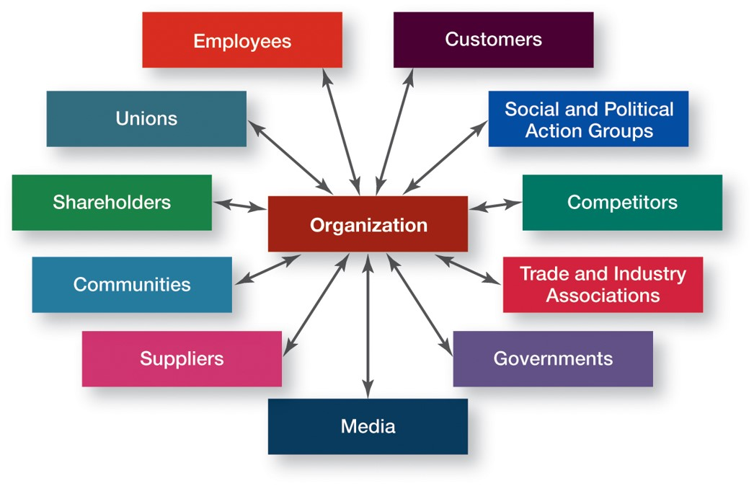
Common Organizational Stakeholders
Exhibit 2.3 Organizational Stakeholders

Slide 15
Good Stakeholder Relationships:
Can lead to desirable organizational outcomes
Can affect organizational performance
Demonstrate doing the “right” thing

Slide 16
Learning Objective 2.3
Define organizational culture and explain why it’s important.

Slide 17
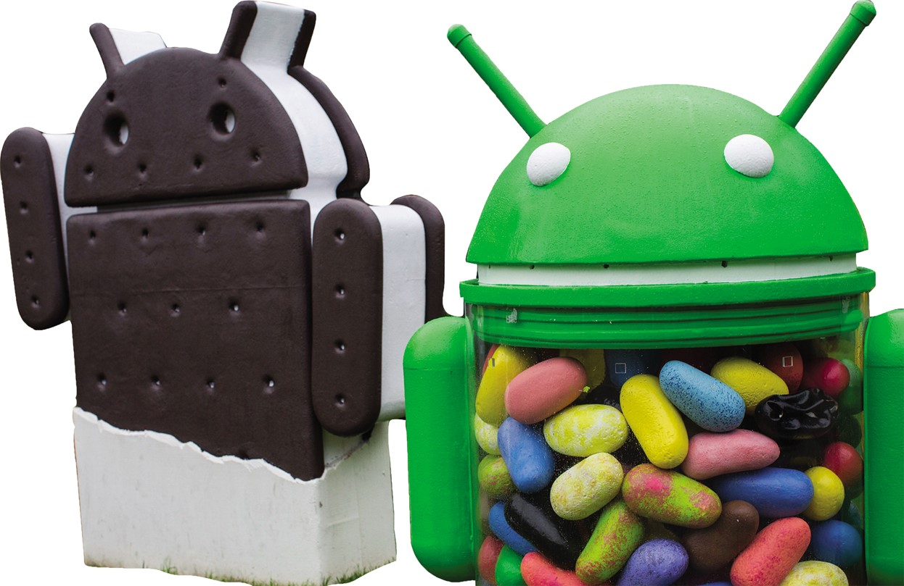
What Is Organizational Culture?

Slide 18
Organizational Culture
Shared values, principles, traditions, and ways of doing things that influence the way organization’s members act.

Slide 19
Culture Is:
Perceived
Descriptive
Shared

Slide 20
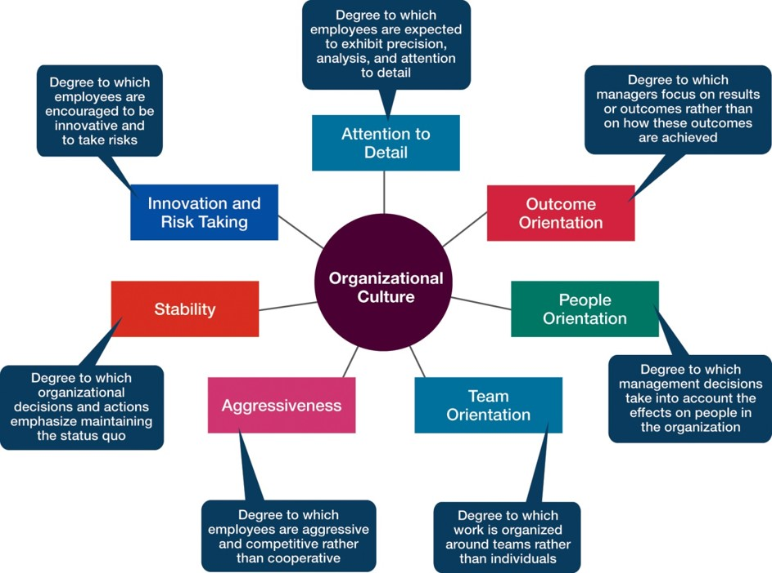
Dimensions of Culture
Exhibit 2.4

Slide 21
Learning Organizational Culture
Where Does Culture Come From? | How Do Employees Learn the Culture?
Usually reflects the vision or mission of founders. | Organizational stories: narrative tales of significant events or people.
Founders project an image of what the organization should be and what its values are. | Corporate rituals: repetitive sequences of activities that express and reinforce important organizational values and goals.
Founders can “impose” their vision on employees because of new organization’s small size. | Material symbols or artifacts: layout of facilities, how employees dress, size of offices, material perks provided to executives, furnishings, and so forth.
Organizational members create a shared history that binds them into a community and reminds them of “who we are.” | Language: special acronyms; unique terms to describe equipment, key personnel, customers, suppliers, processes, products.

Slide 22
Learning Objective 2.4
Describe how organizational culture affects managers.

Slide 23
How Does Organizational Culture Affect Managers?
Effect on what employees do and how they behave
Effect on what managers do

Slide 24
How Does Culture Affect What Employees Do?
Strong cultures:
cultures in which the key values are deeply held and widely shared.

Slide 25
Strong Cultures Can:
Substitute for formal rules and regulations
Create predictability, orderliness, and consistency

Slide 26
How Does Culture Affect What Managers Do?
Say What?
Ten percent of executives say they have not identified or communicated an organizational culture.

Slide 27
Company Values Affect Managers’ Behavior
“Ready-aim-fire” versus “Ready-fire-aim”

Slide 28
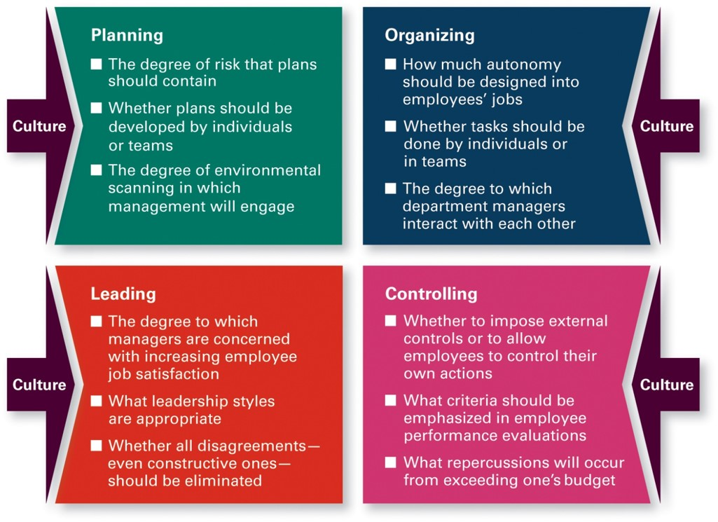
Managerial Decisions Influenced by Culture
Exhibit 2.5 Managerial Decisions Affected by Culture
Source: Robbins, Stephen P., Coulter, Mary, Management, 13th E d., © 2016, p. 86. Reprinted and electronically reproduced by permission of Pearson Education, Inc., New York, N Y.

Slide 29
Learning Objective 2.5
Describe current issues in organizational culture.

Slide 30
What Are Current Issues in Organizational Culture?
Organizational culture can drive employee productivity, engagement, and retention

Slide 31
Creating a Customer-Responsive Culture
Exhibit 2.6 Creating a Customer-Responsive Culture
Characteristics of Customer- Responsive Culture | Suggestions for managers
Type of employee | Hire people with personalities and attitudes consistent with customer service: friendly, attentive, enthusiastic, patient, good listening skills
Type of job environment | Design jobs so employees have as much control as possible to satisfy customer, without rigid rules and procedures
Empowerment | Give service-contact employees the discretion to make day-to-day decision on job-related activites
Role clarity | Reduce uncertainty about what service-contact employees can and cannot do by continual training on product knowledge, listening, and other behavioral skills
Consistent desire to satisfy and delight customer | Clarify organization’s commitment to doing whatever it takes, even if it’s outside an employee’s normal job requirements

Slide 32
Creating an Innovative Culture
Challenge and involvement
Freedom
Trust and openness
Idea time
Playfulness/humor
Conflict resolution
Debates
Risk taking

Slide 33
Creating a Sustainability Culture
Get everyone involved in defining what sustainability means to the organization
Get employees involved in finding ways to be more sustainable.
Create rituals to reinforce the importance of sustainability.
Use rewards.

Slide 34
Creating an Ethical Culture
Ethical culture:
one in which the shared concept of right and wrong behavior in the workplace reflects the core values of the organization and influences the ethical decision making of employees.

Slide 35
Creating a Learning Culture
Creating a learning culture starts with buy-in at the top.
  Organizational leaders must understand what it takes for a learning culture to work and be committed to it.

Slide 36

Copyright
This work is protected by United States copyright laws and is provided solely for the use of instructors in teaching their courses and assessing student learning. Dissemination or sale of any part of this work (including on the World Wide Web) will destroy the integrity of the work and is not permitted. The work and materials from it should never be made available to students except by instructors using the accompanying text in their classes. All recipients of this work are expected to abide by these restrictions and to honor the intended pedagogical purposes and the needs of other instructors who rely on these materials.

